Slide 1
My project at a glance
KS3 (Y8 in mind) scheme of work.
Introduction to climate change and different responses.
State of play.
How did we get here?
Why should we change?
What can we do?
Inspirational people.
Reflection/ individual responses.

Slide 2
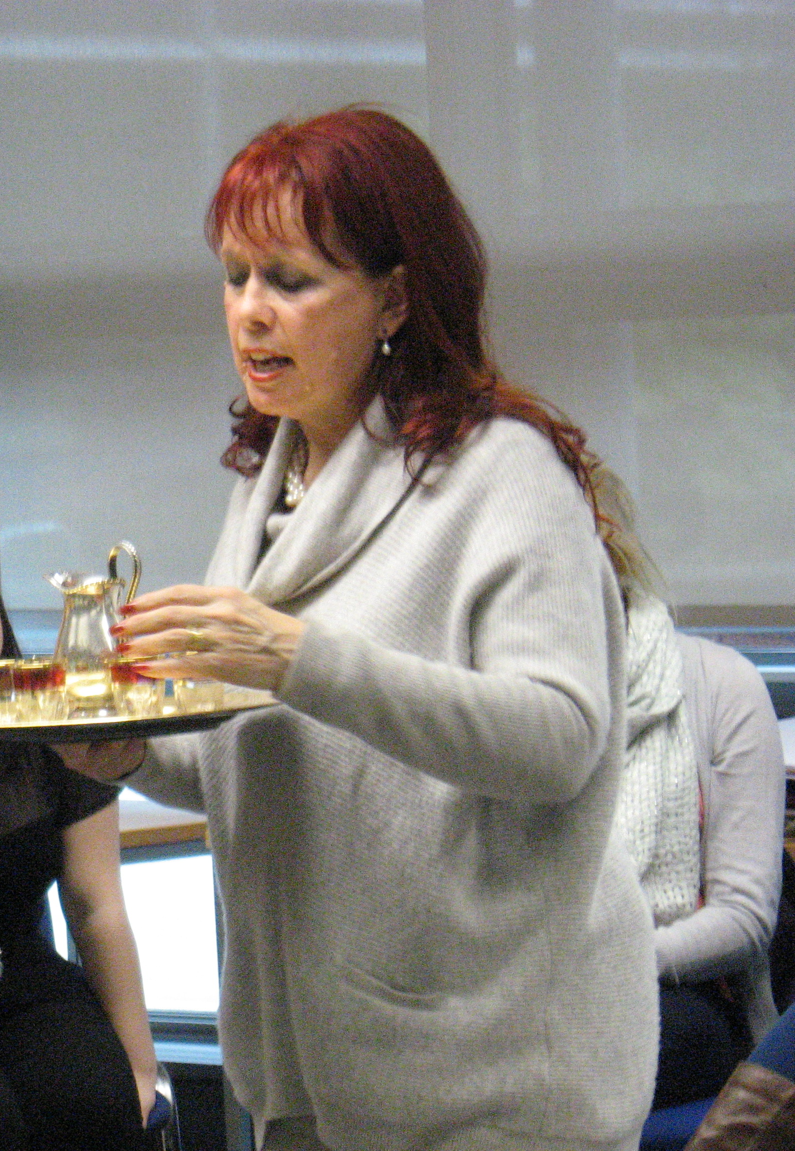
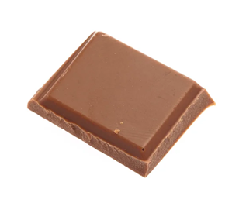
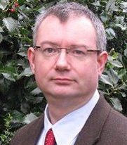

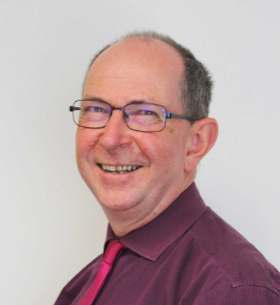
Themes and ideas
Throughout, I’ve tried to take elements of things we’ve seen in the evening sessions:
Experiential learning where possible/appropriate.
The use of stories.
“Let the text breath”
The use of pictures.
Notes:
Professor Nick Adams, Scriptural reasoning. Not suitable for Y8 necessarily, but you can use text to provoke a discussion.

Slide 3
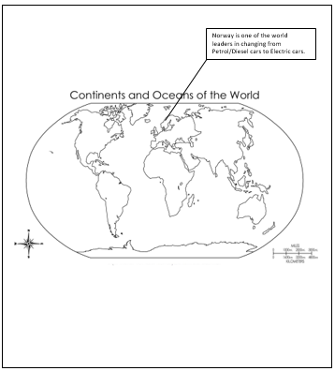
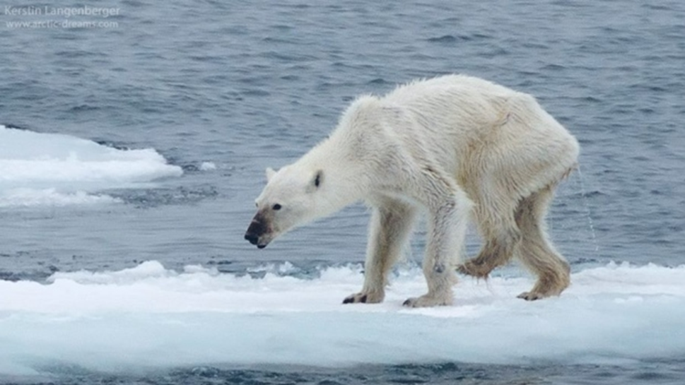
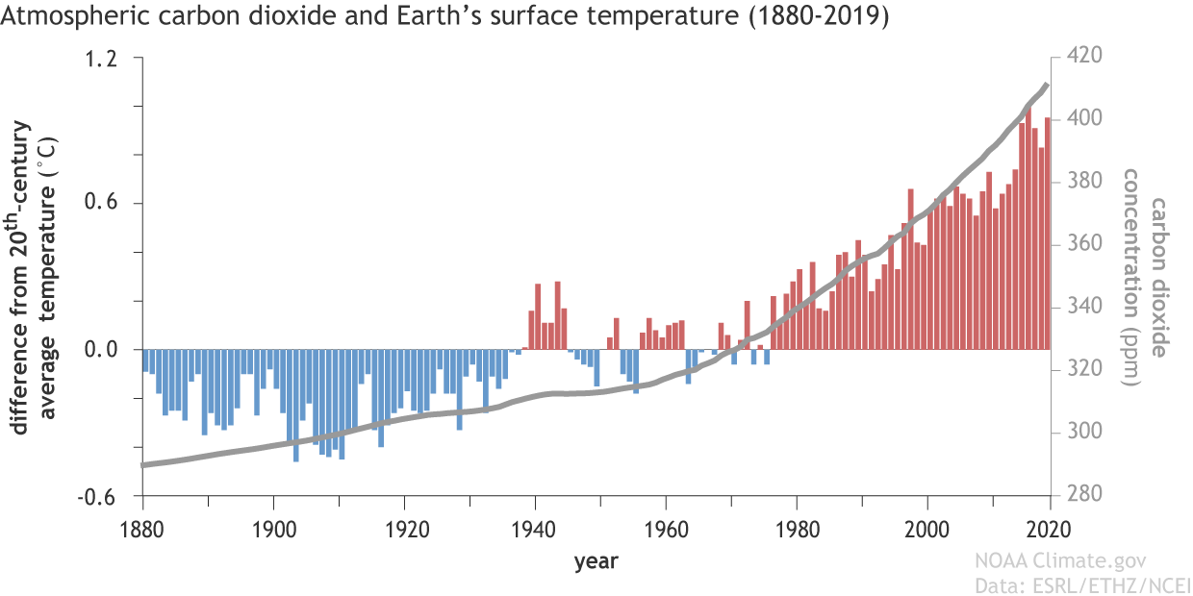
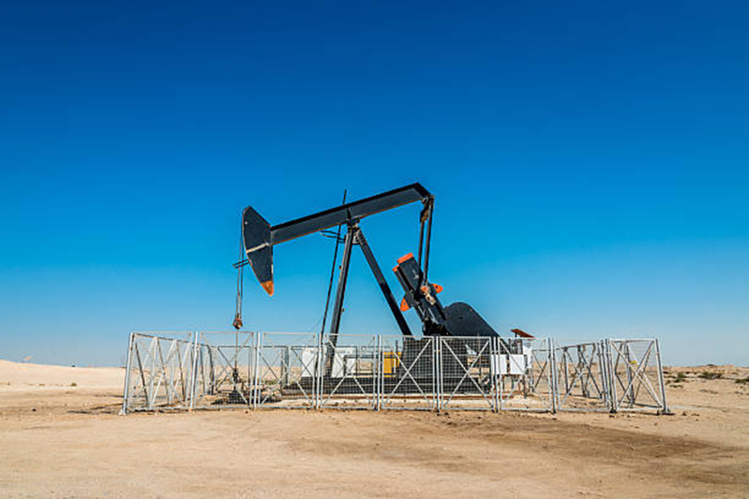
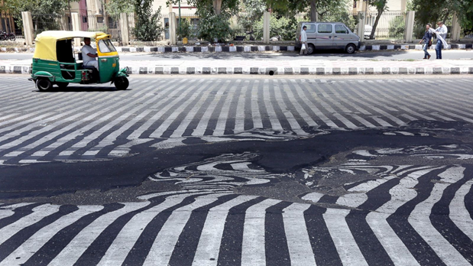
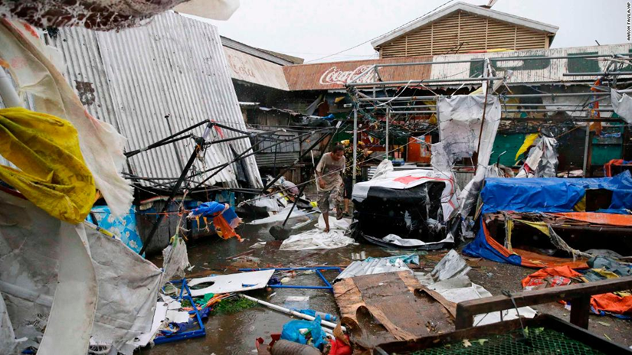
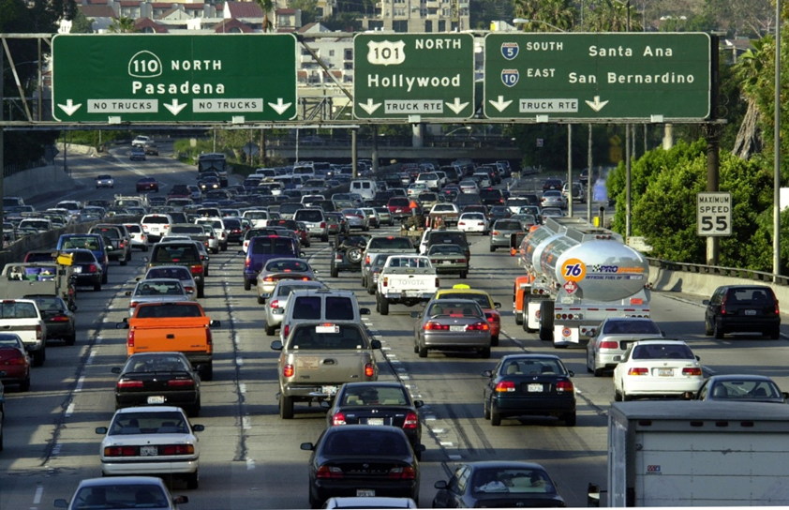
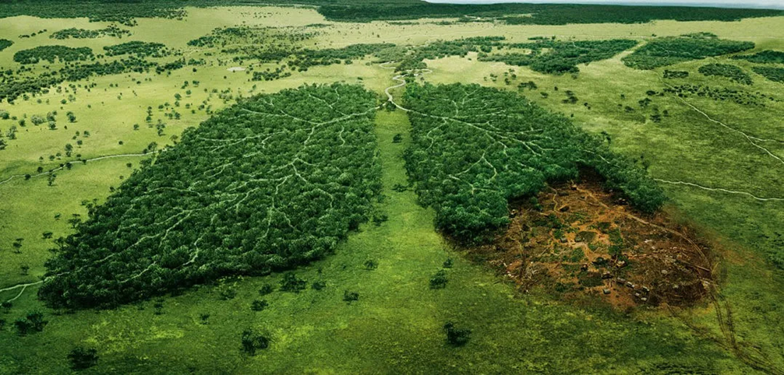
1. State of play.
An introduction to the topic.
To make sure everyone knows what climate change is an understands “the basics”.
Learning Intention: To understand what climate change is.
Success Criteria 1 (SC1): To understand what is meant by climate change.
SC2: To understand some of the causes of climate change.
SC3: To understand some of the effects of climate change.

Slide 4

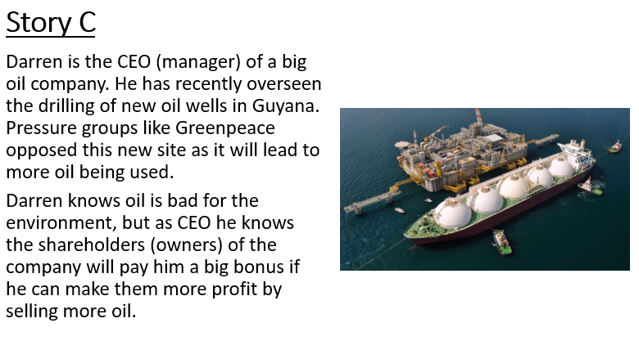
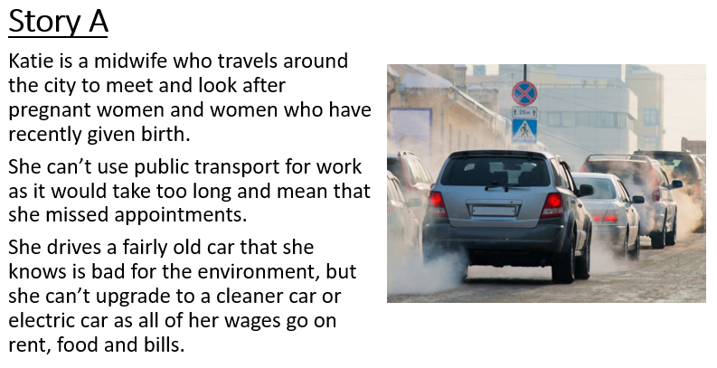
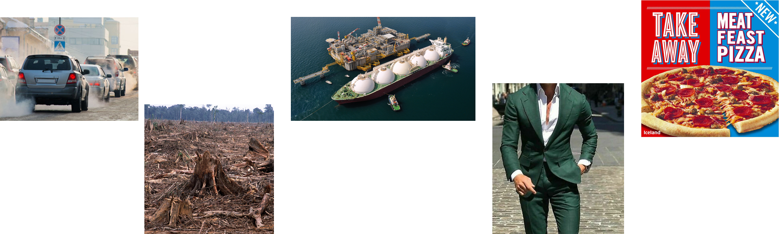
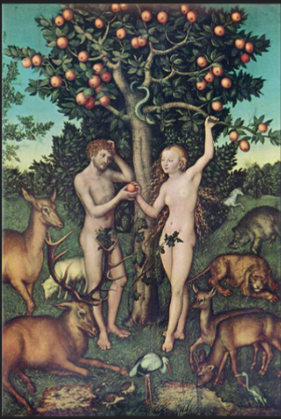
2. How did we get here?
Learning Intention: To understand why we are allowing climate change to happen.
SC1: To understand why people do things that cause climate change.
SC2: To look at Buddhist explanations.
SC3: To look at Christian explanations.
Genesis 3
Notes:
Discussion about how it isn’t black and white all of the time.

Slide 5
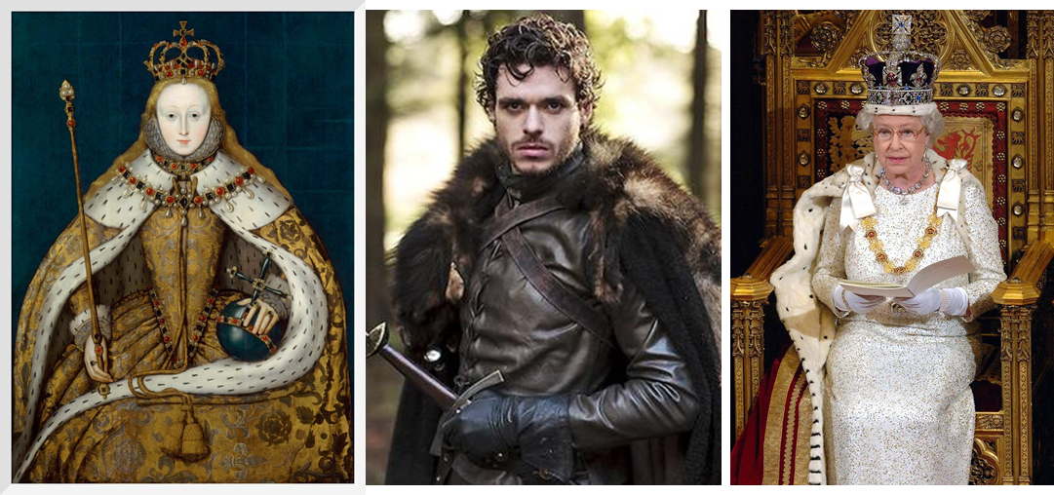
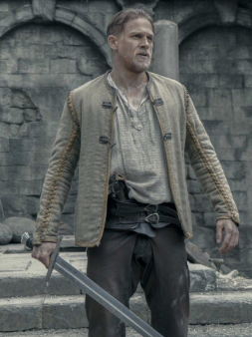
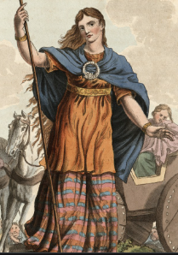

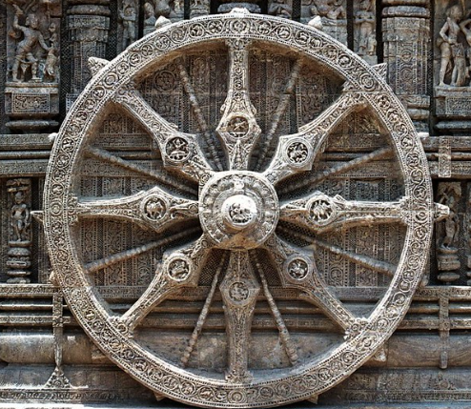
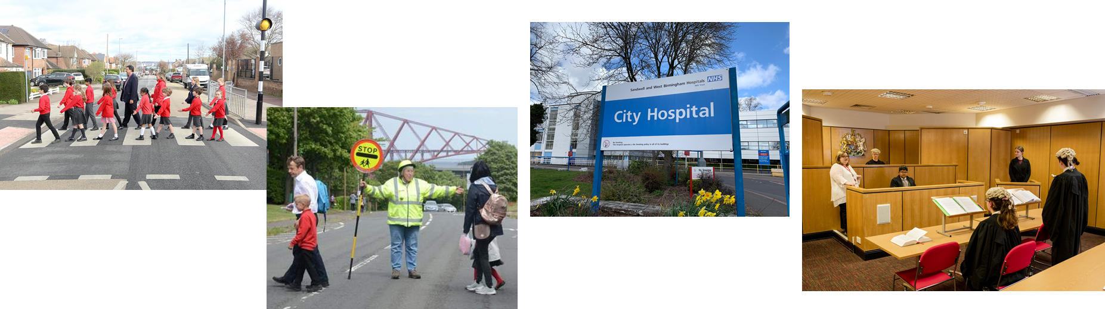
3. Why should we change?
Learning Intention: To understand what religious responses are to climate change.
SC1: To understand some Christian responses.
SC2: To understand some Islamic responses.
SC3: To understand some Buddhist responses.
Dominion and Stewardship
Concept cracking
To be completed
Maslahah
(public interest)

Slide 6
4. What can we do?
Learning Intention: To understand what we can do to reduce climate change.
SC1: To be confirmed…
SC2: To experience one thing we can do – chocolate!
SC3: To complete a “diamond 9” on things we can do.

Slide 7

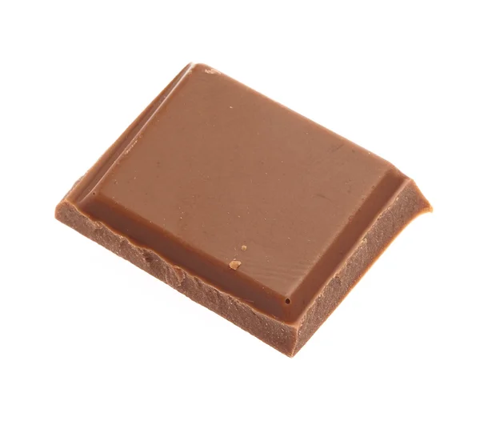


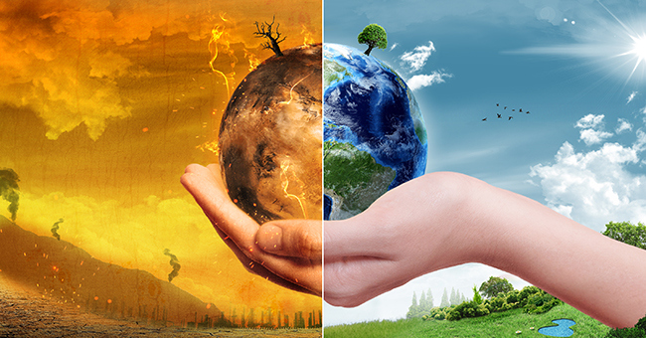
Success criteria 2: To experience one thing we can do – chocolate!
As we have seen over the last few lessons, climate change is caused by human choices. In a moment you’ll make a choice that represents the choices we make everyday.
You will have the choice between one piece of “climate change friendly” Rainforest Alliance or Fairtrade chocolate, or two pieces of “normal” chocolate.
What will you pick?

Slide 8
Success criteria 2: To experience one thing we can do – chocolate!
Answer these questions in full sentences.
Did you choose one piece or two?
Why did you make that decision?
Did you feel guilty or pressured to pick a certain one?
What do you think Christians, Buddhists or Muslims might say about people who chose two? (What caused them to do it?)
Are there choices you make everyday that impact the climate? If so, could you make a change?
Notes:
Q4: temptation from devil, original sin, weakness, greed, ignorance, craving, lack of care for others. Maslahah.

Slide 9

Success criteria 3: To complete a diamond 9 on things we can do.
You now need to complete the “diamond 9” with 9 things we can do to help reduce climate change.
You can swap one or two of your own if you have thought of something over the last few lessons.
Most achievable
Switch to plant based milk.
Reduce meat consumption.
Buy less clothes.
Eat chocolate from sustainable manufacturers.
Avoid/reduce flying on a plane.
Waste less food.
Don’t waste energy at home e.g. lighting and heating.
Recycle more items –even difficult ones!
Buy less toys/things.
Take shorter showers.
Least achievable

Slide 10
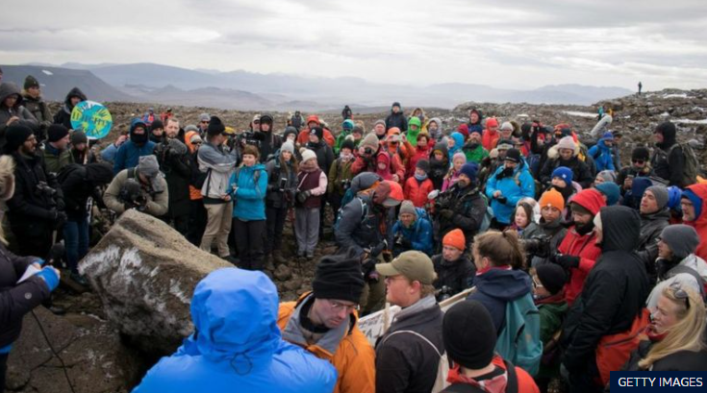
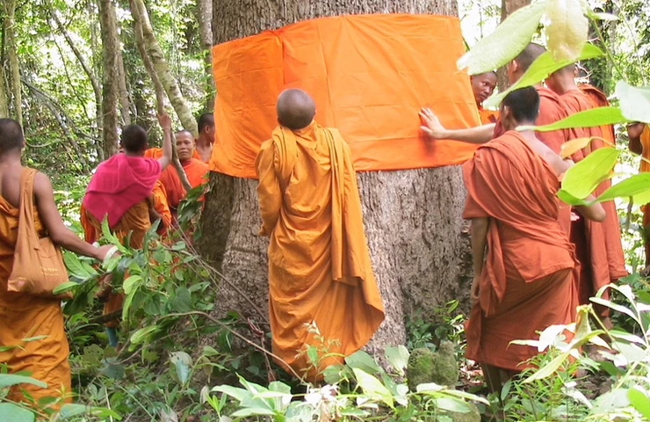
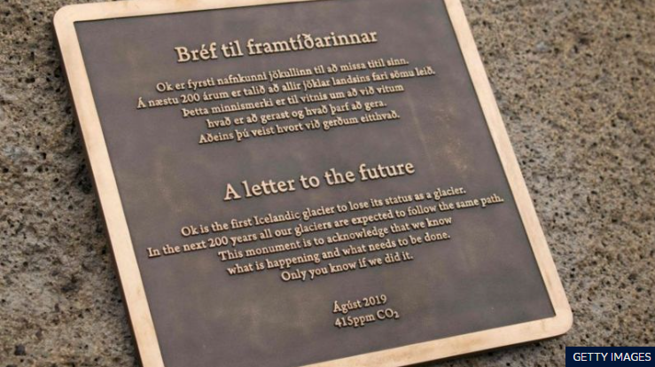
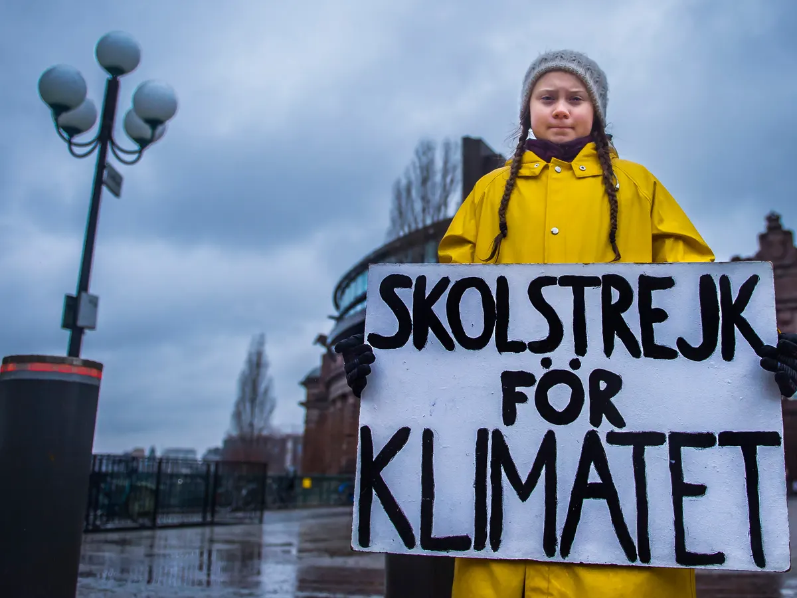
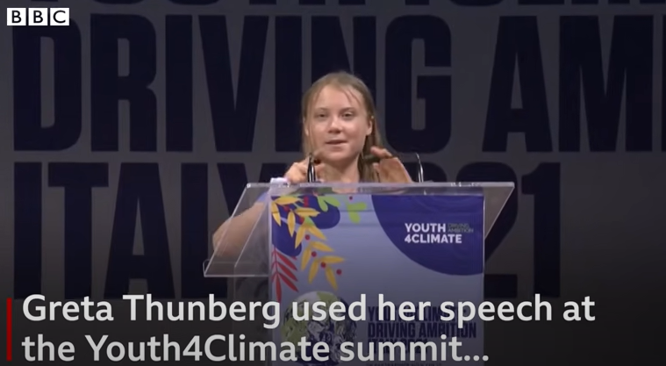
5. Inspirational people.
https://www.bbc.co.uk/newsround/49405023#:~:text=Iceland%20has%20marked%20the%20melting,warmest%20July%20ever%20on%20record.
LI and SC to be confirmed…
What is happening here?
https://www.youtube.com/watch?v=ZwD1kG4PI0w
Notes:
Monks Community Forest in Cambodia, 183 sq. KM. Early 2000s, Monk Bun Saluth had the idea. To harm an ordained monk is a religious taboo and legal offence. It has worked.
“Ok is the first Icelandic glacier to lose its status as a glacier. In the next 200 years all our glaciers are expected to follow the same path. This monument is to acknowledge that we know what is happening and what needs to be done. Only you know if we did it. –August 2019”.

Slide 11
6. Reflection/ individual responses.
LI and SC to be confirmed…
Possible get them to look back over the scheme of work and see if their view has changed.
Speech?
Leaflet?
Newspaper article?
Ideas would be very welcome here.

Slide 12
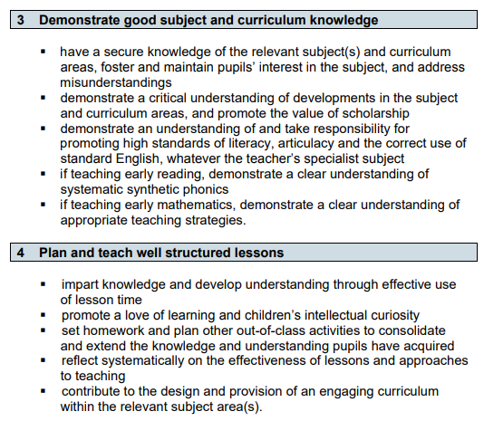
Teachers’ standards

Slide 13
Thank you for listening
There is now time for questions, comments and suggestions.
I would be happy to here suggestions for:
where non-religious world views might fit in well
ideas for lesson 6 – reflection activity
any other inspiring people you would love to talk about

